Slide 1
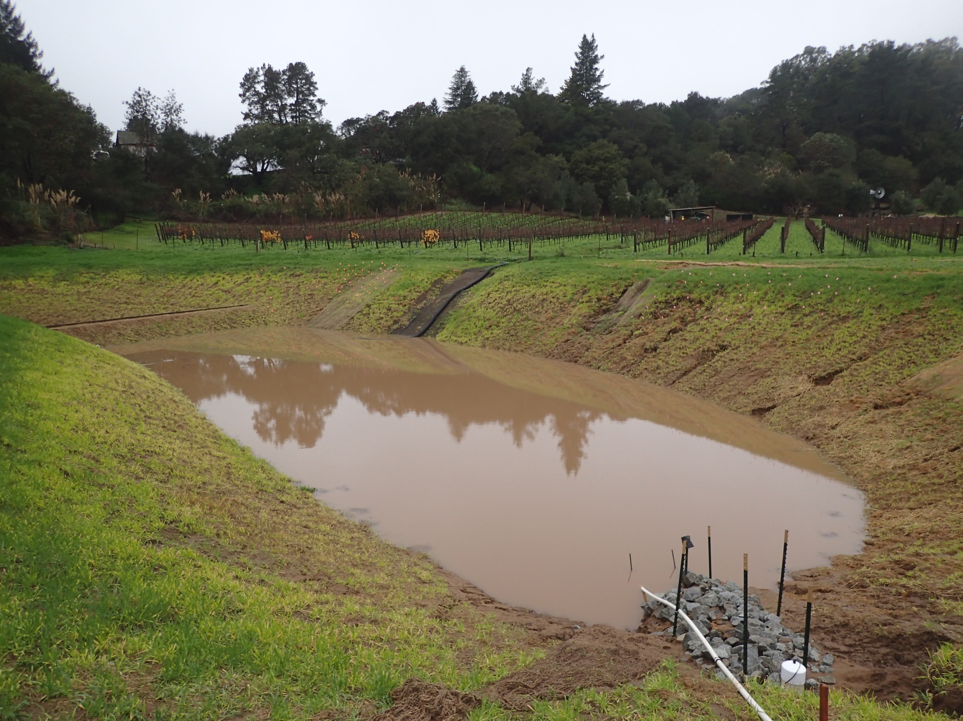

Using machine learning to incorporate water quality improvements for mapping MAR suitability
International Symposium for Managed Aquifer Recharge
Madrid, Spain
21 May 2019
Galen Gorski, Andrew Fisher, Sarah Beganskas, Jenny Pensky, Hannah Dailey, and Calla Schmidt

Slide 2
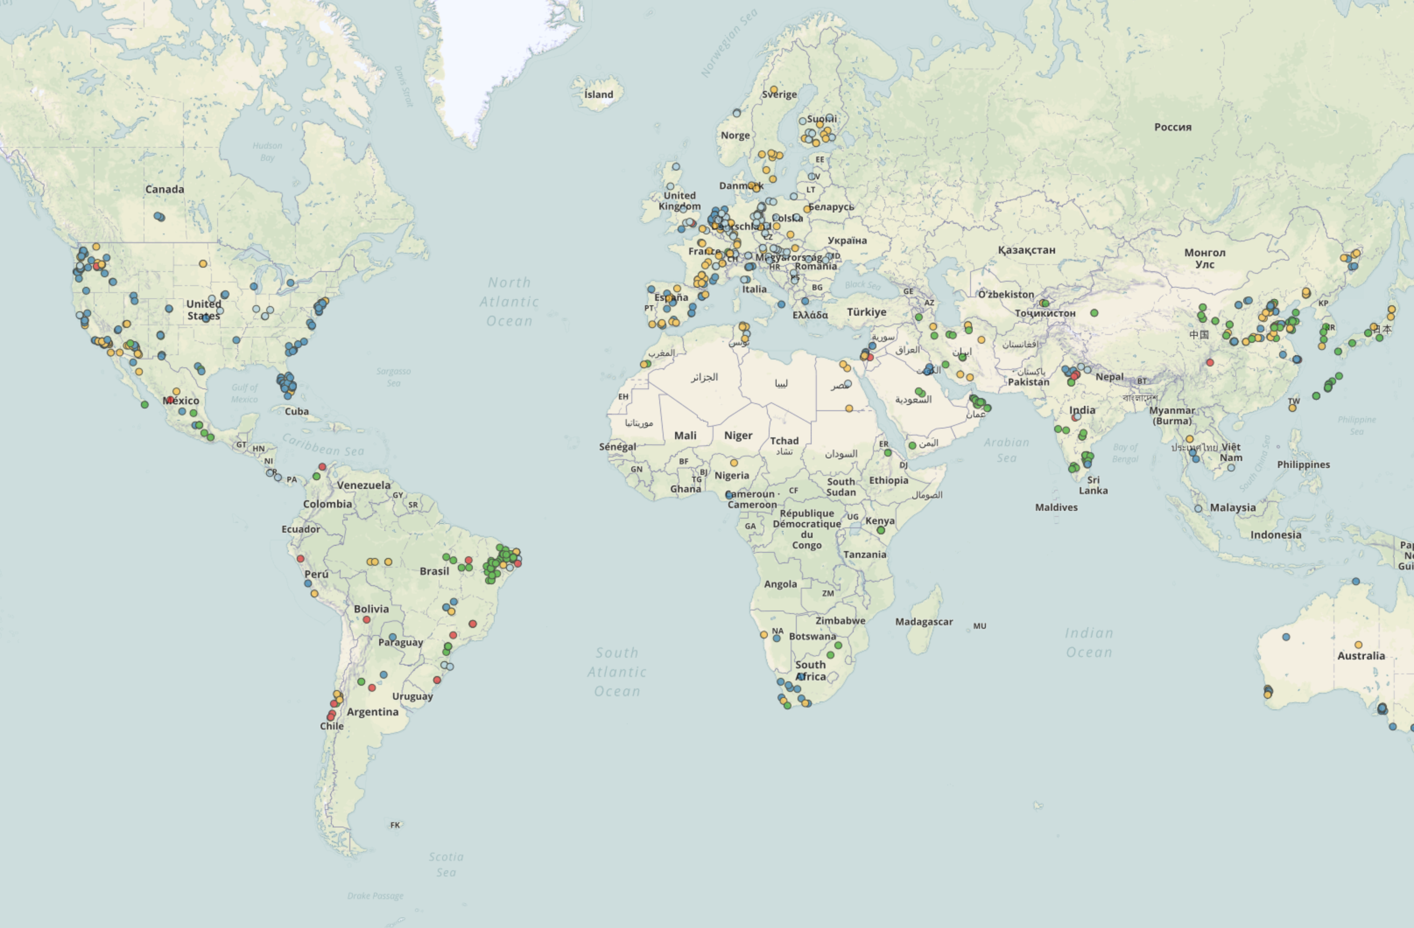

How does artificial recharge affect groundwater quality?

Slide 3
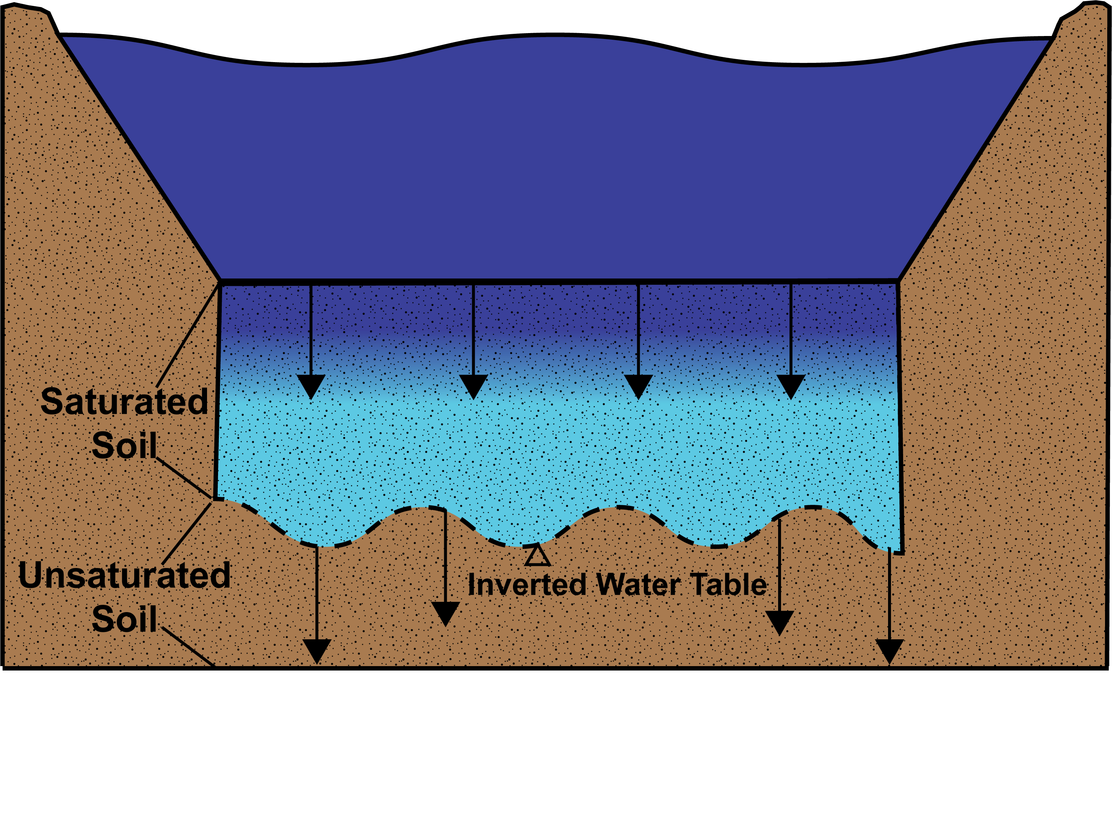
Recharge can remove contaminants
Non-pristine water can be improved during infiltration

Slide 4
Recharge can remove contaminants
DENITRIFICATION
A naturally occurring process that removes nitrate during infiltration

Slide 5
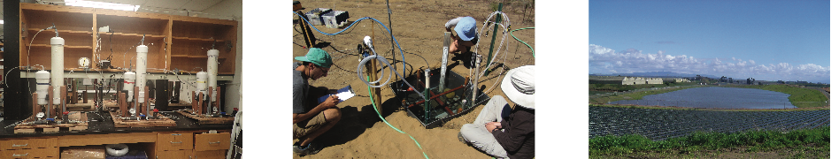
Denitrification during infiltration
Requires an abundance of carbon and a lack of oxygen
Represents a permanent sink for nitrate
Naturally occurring process during infiltration
Denitrification

Slide 6
Modeling denitrification during infiltration
Leverage this dataset to model denitrification during infiltration on a landscape scale
Naturally occurring process during infiltration
Denitrification

Slide 7
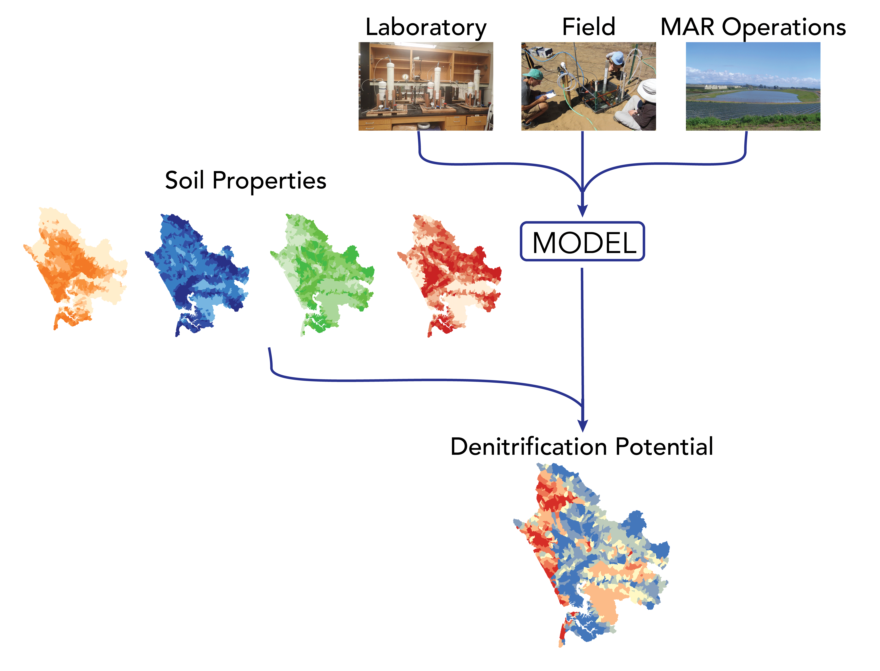
measurements of denitrification during infiltration from four sites at three different scales
Develop, calibrate and validate models of denitrification
Use modeled relationships, in conjunction with spatially mapped soil data to make predictions of denitrification

Slide 8
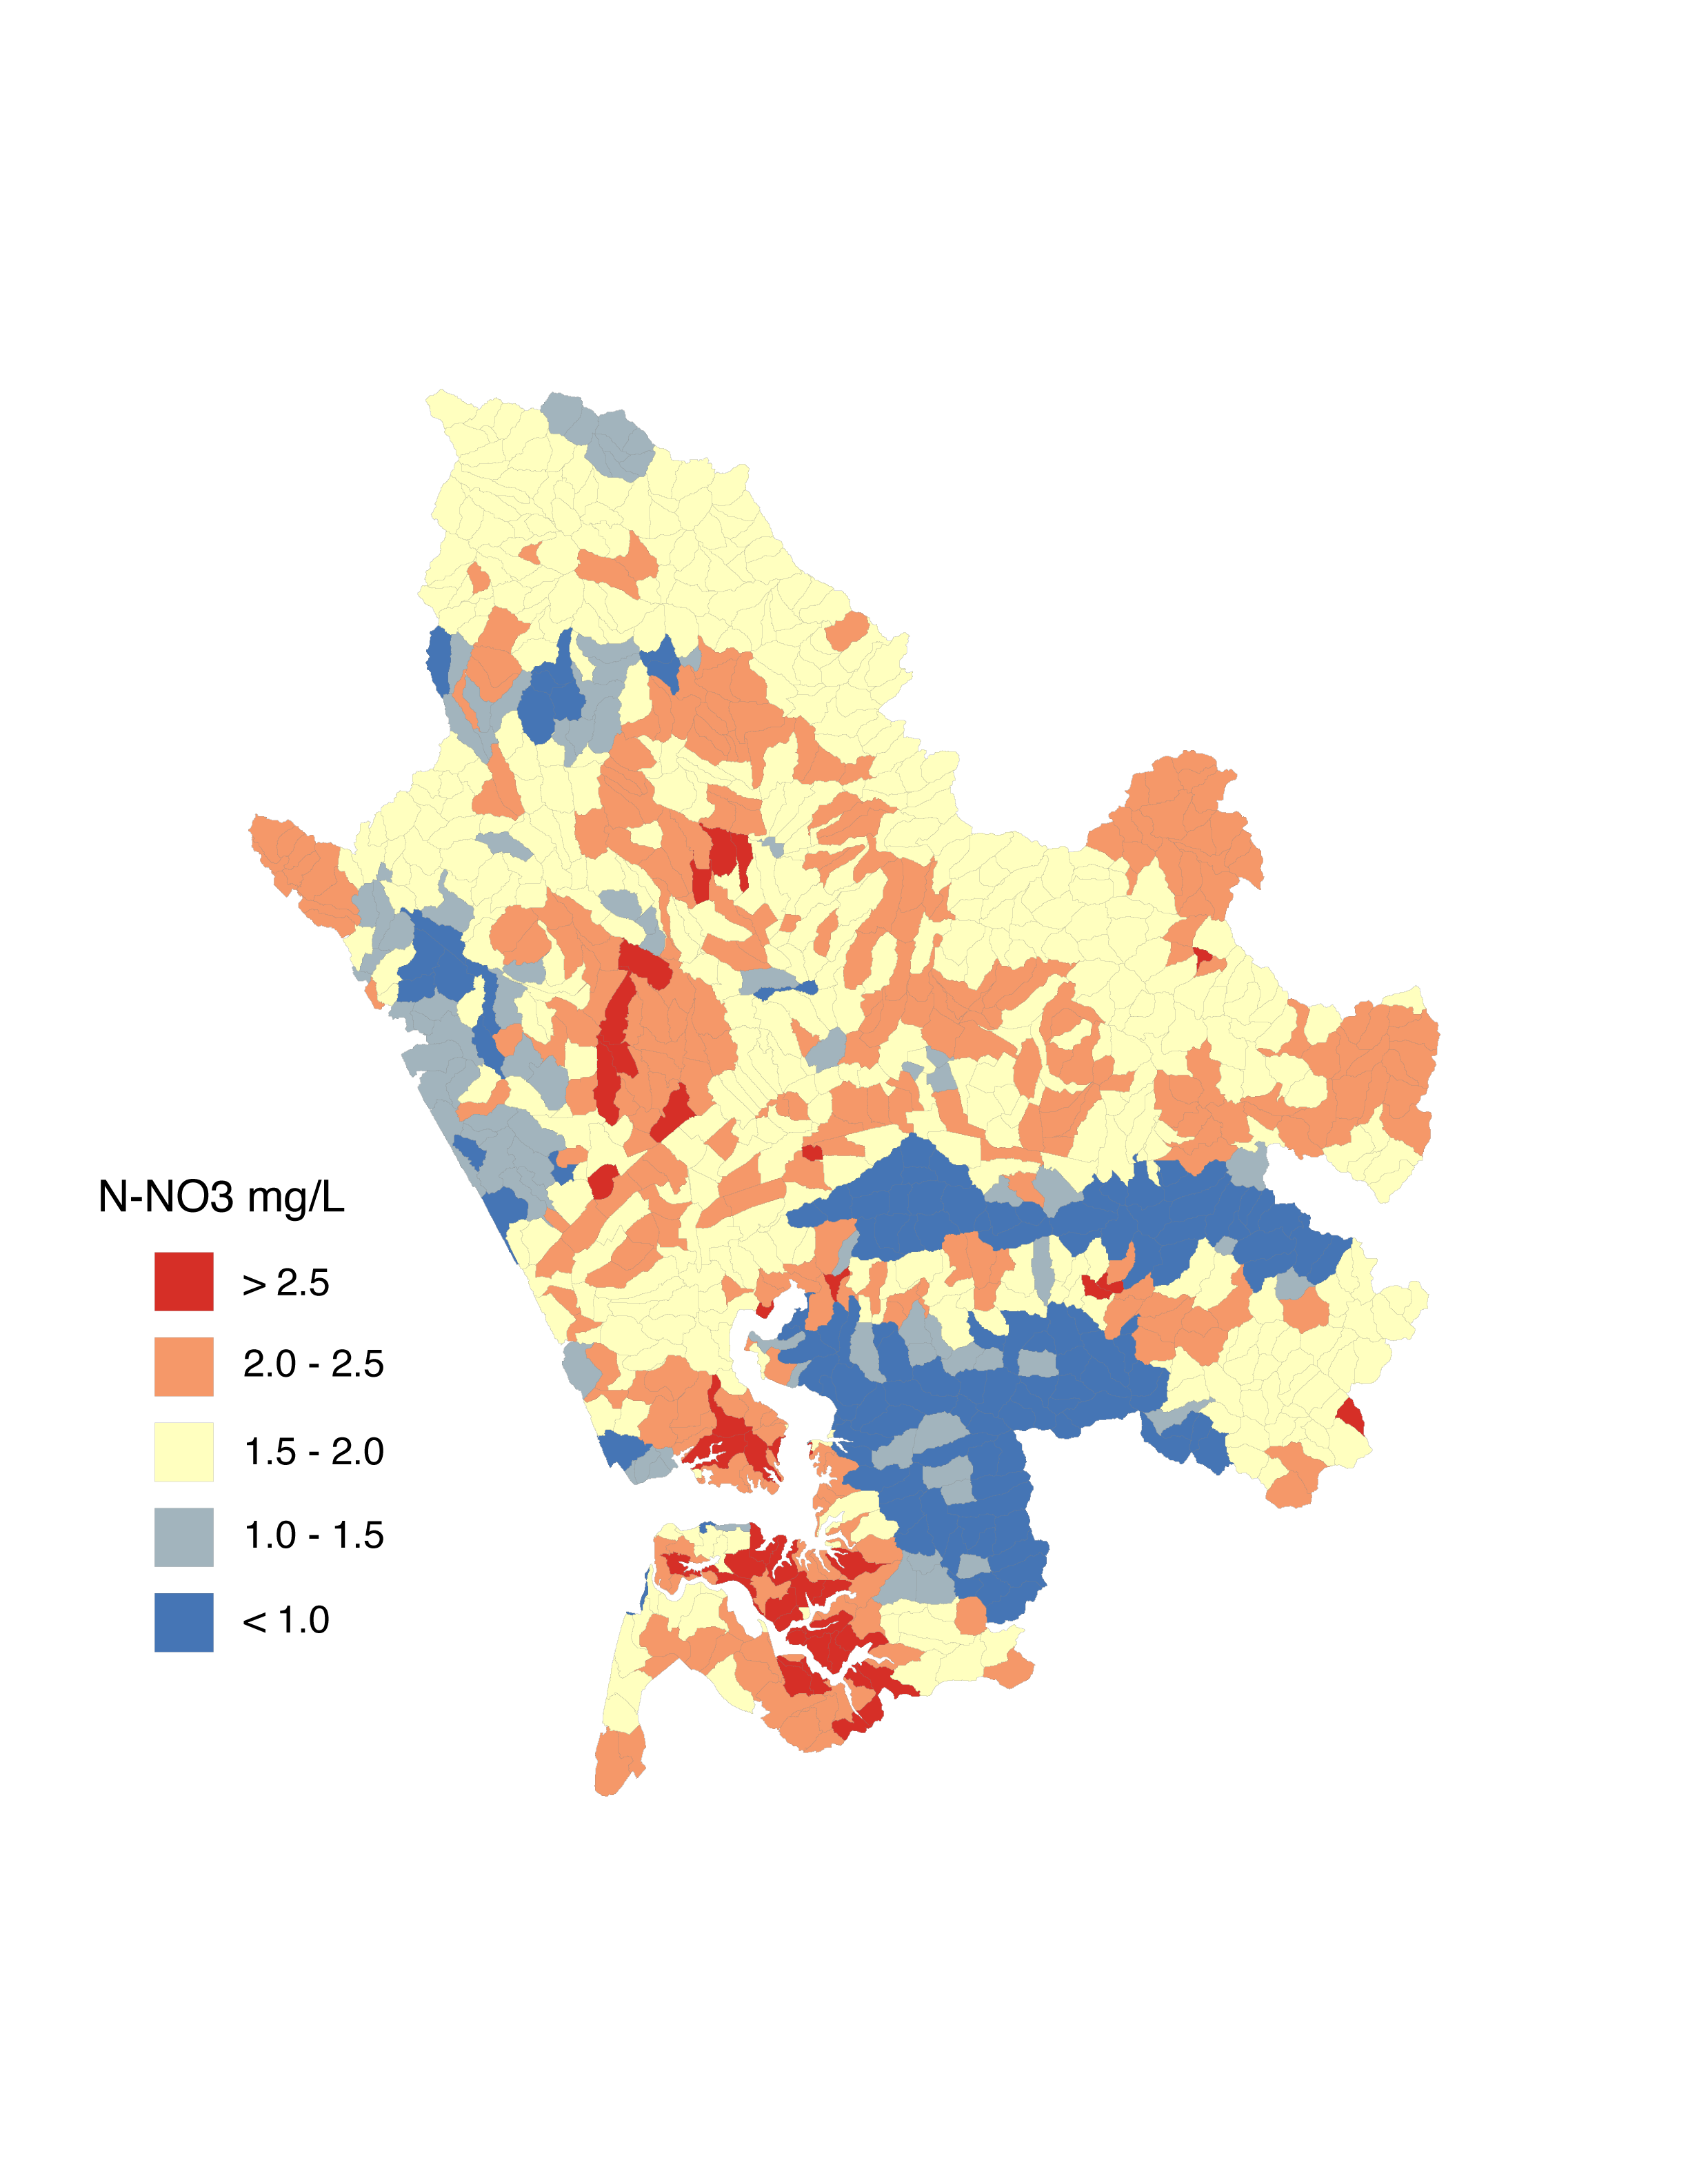
measurements of denitrification during infiltration from four sites at three different scales
Develop, calibrate and validate models of denitrification
10 km
10 km
10 km
10 km
Use modeled relationships, in conjunction with spatially mapped soil data to make predictions of denitrification
Amount of nitrate removed
10 km
10 km

Slide 9
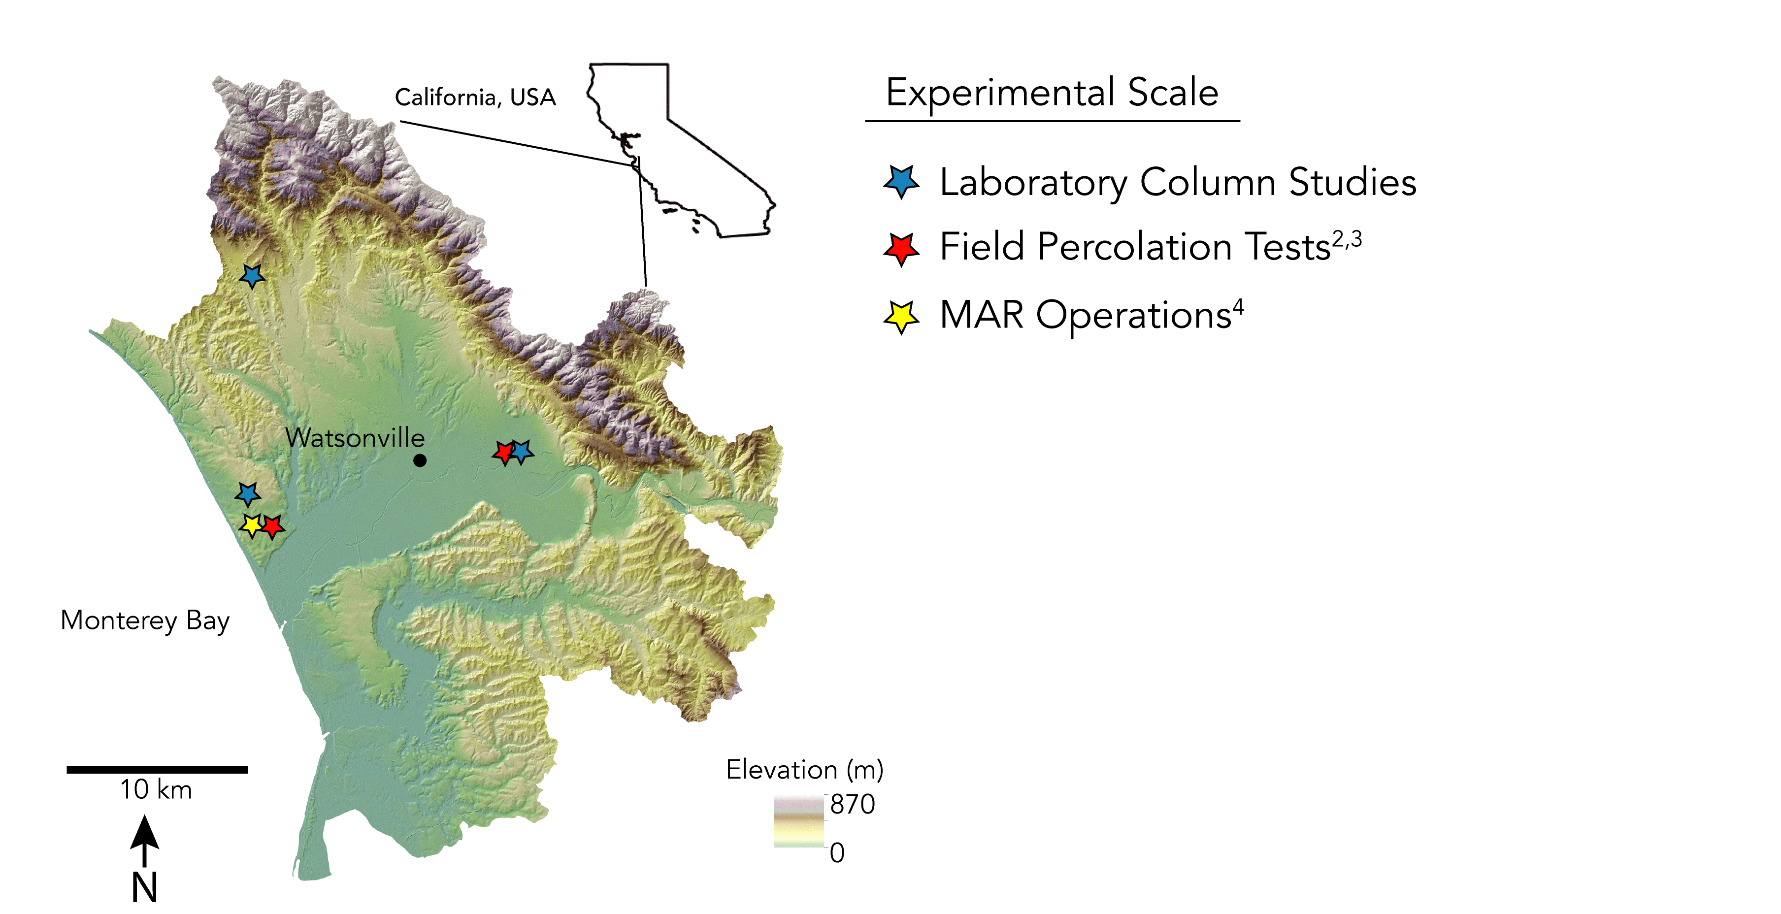

Slide 10
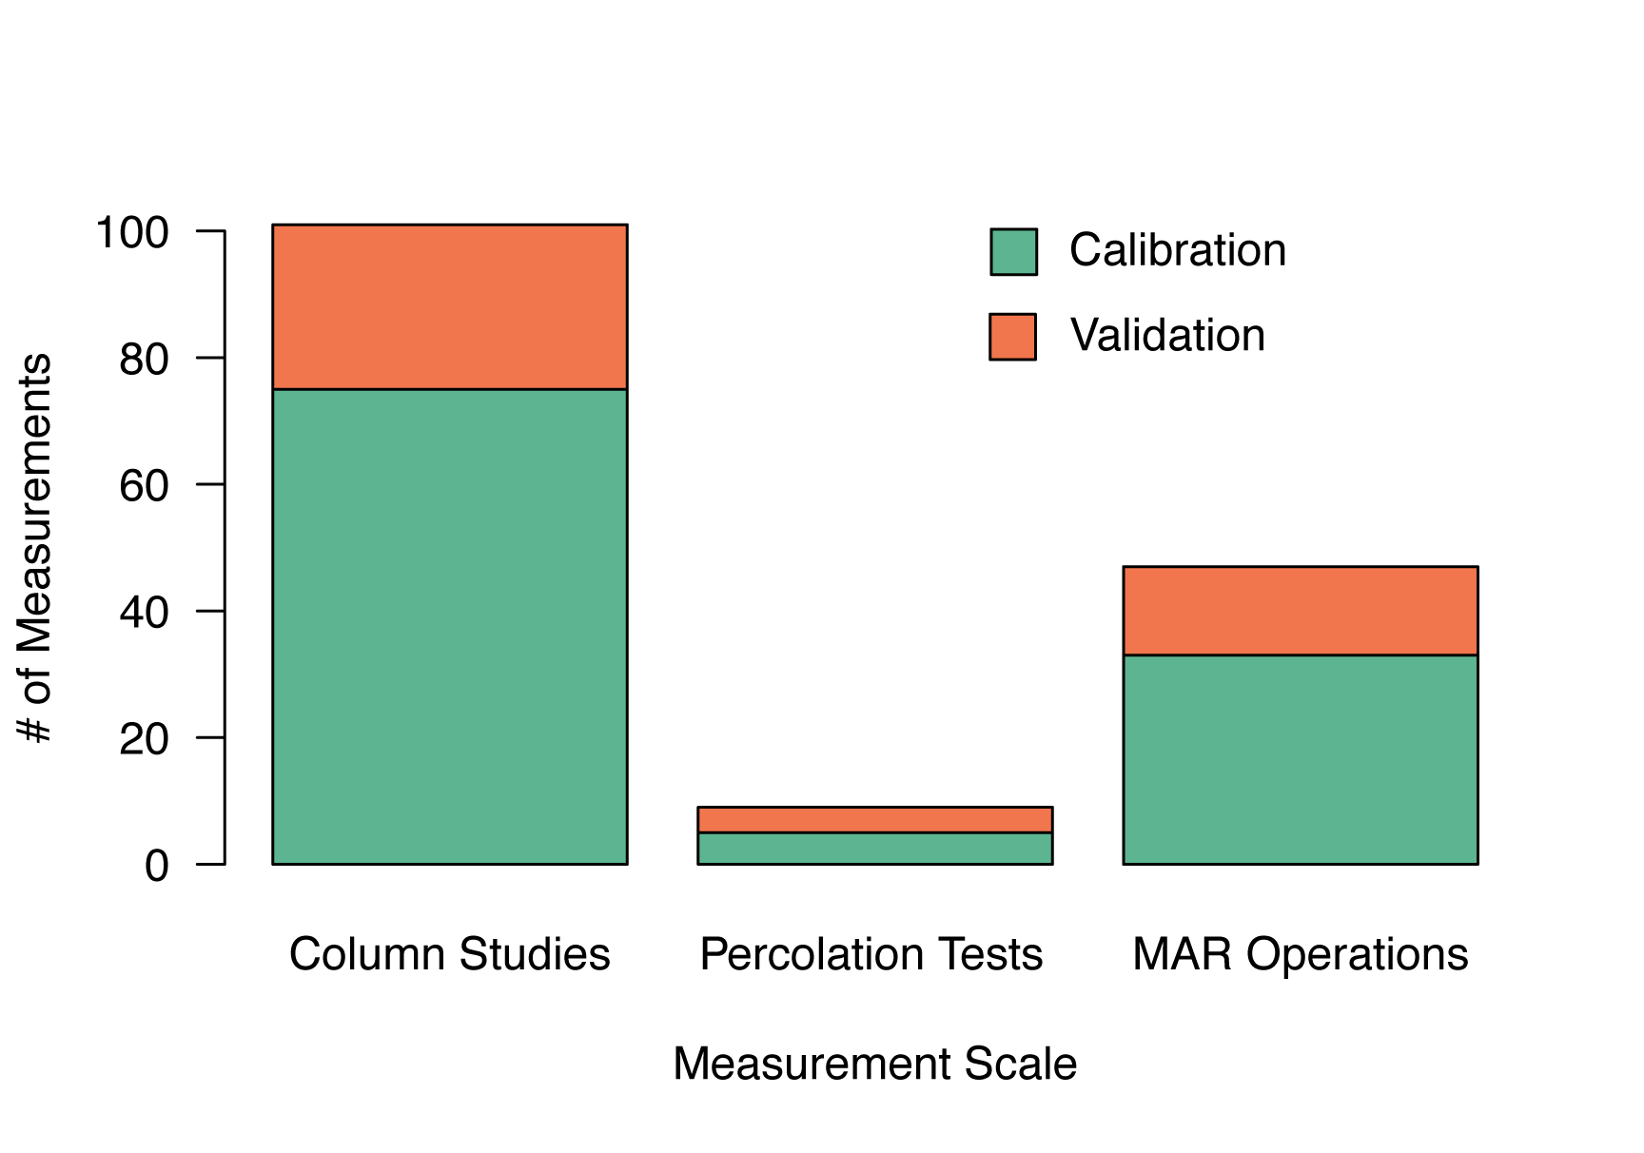
Data split into calibration (75%) and validation (25%) sets to develop models

Slide 11
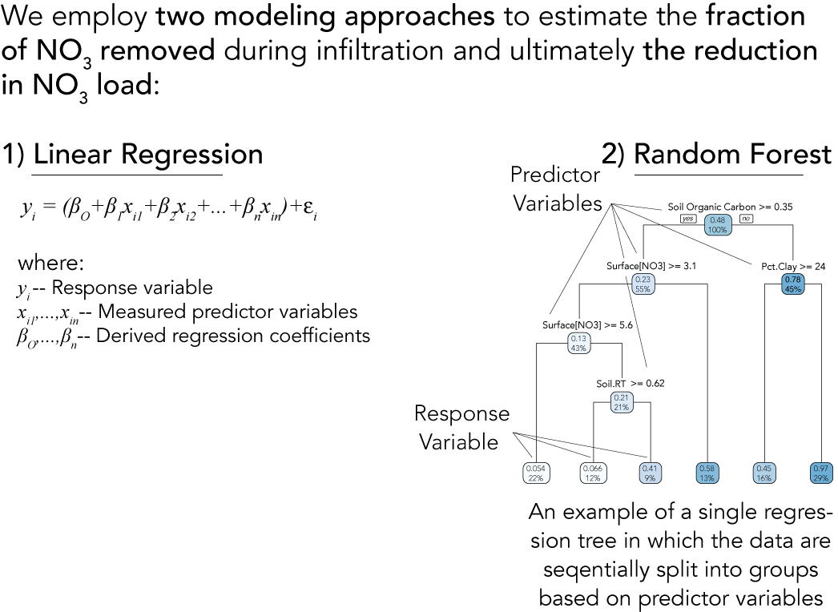
Model Development
Random Forest
Statistical technique
Robust with non-linear relationships and missing data
Easy to interpret results
Best performer out of several modeling approaches

Slide 12
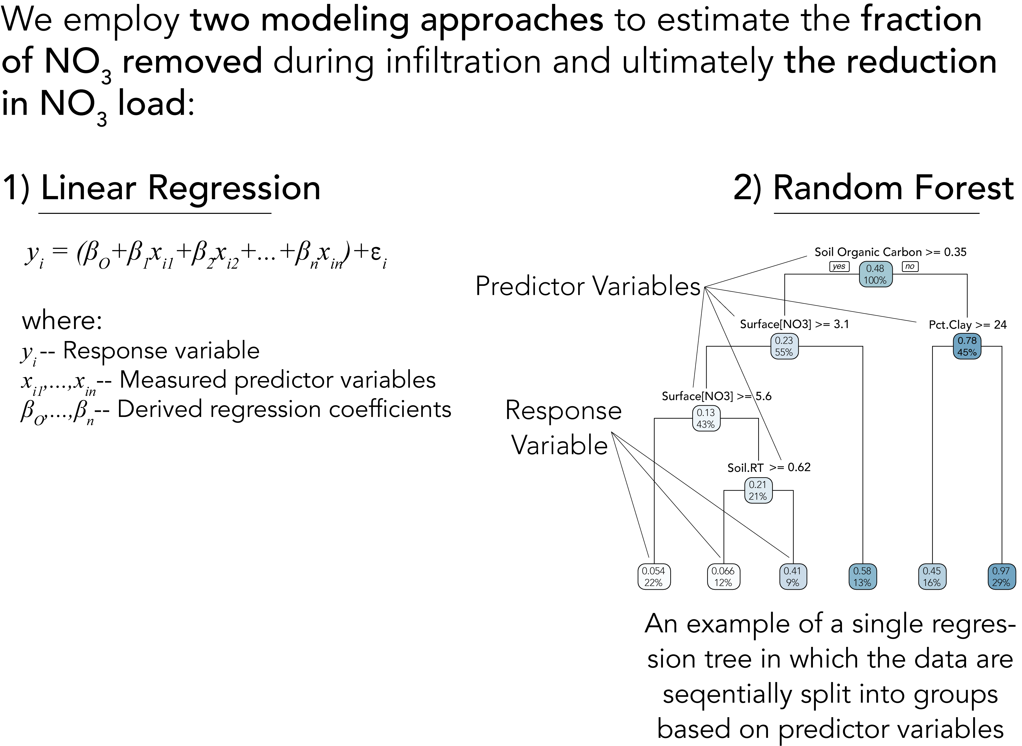
Model Development
Random Forest
Response Variable
Amt NO₃ Removed =[NO₃]_{initial} – [NO₃]_{final}
Predictors
Soil Residence Time
[NO₃]_{initial}
[DOC]_{initial}
Soil Organic Carbon
Soil Nitrogen
Percent Clay
Percent Sand
Percent Silt
Temperature
Soil pH

Slide 13
Model Development
Random Forest
Response Variable
Amt NO₃ Removed =[NO₃]_{initial} – [NO₃]_{final}
Predictors
Soil Residence Time
[NO₃]_{initial}
[DOC]_{initial}
Soil Organic Carbon
Soil Nitrogen
Percent Clay
Percent Sand
Percent Silt
Temperature
Soil pH

Slide 14
Model Development
Model Performance
Response Variable
Amt NO₃ Removed =[NO₃]_{initial} – [NO₃]_{final}
Predictors
Soil Residence Time
[NO₃]_{initial}
[DOC]_{initial}
Soil Organic Carbon
Soil Nitrogen
Percent Clay
Percent Sand
Percent Silt
Temperature
Soil pH
Predicted
Amount NO₃ Removed (mg/L)
Measured
Amount NO₃ Removed (mg/L)

Slide 15
measurements of denitrification during infiltration from four sites at three different scales
Develop, calibrate and validate models of denitrification
10 km
10 km
10 km
10 km
Use modeled relationships, in conjunction with spatially mapped soil data to make predictions of denitrification
Amount of nitrate removed
10 km

Slide 16
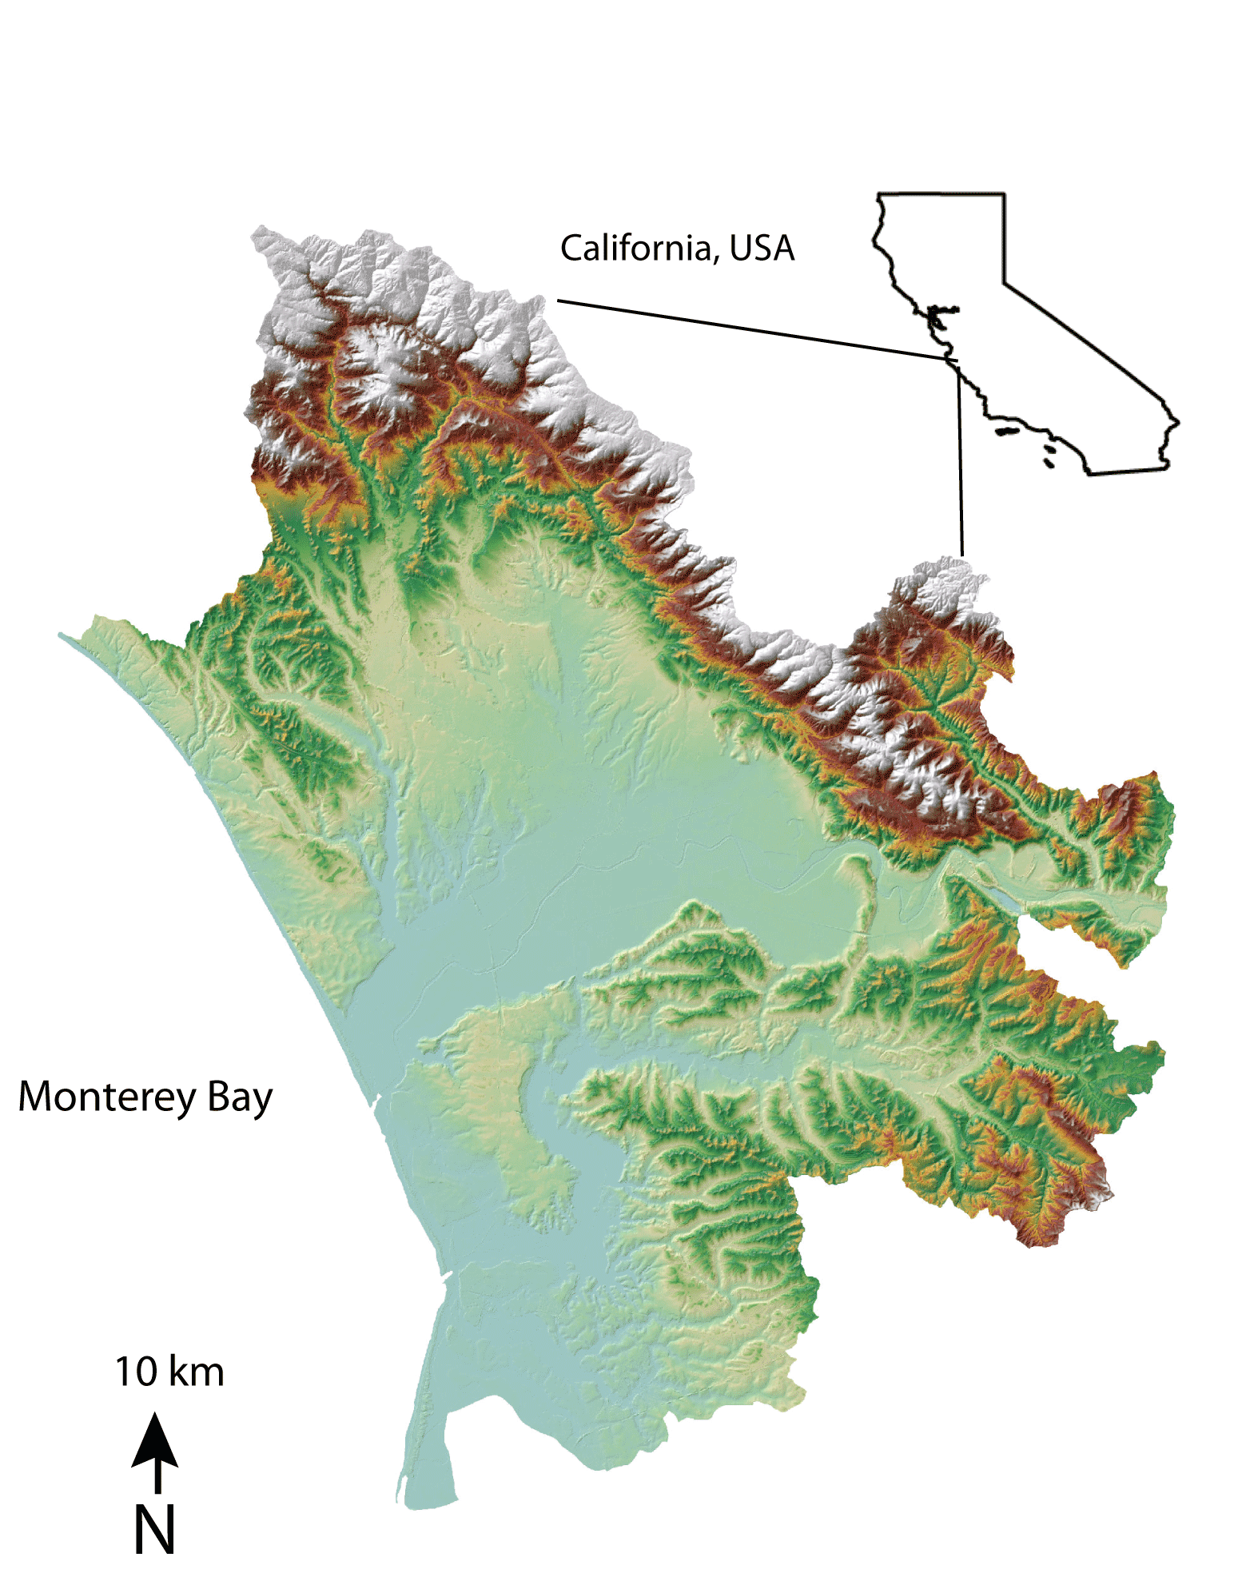

Slide 17
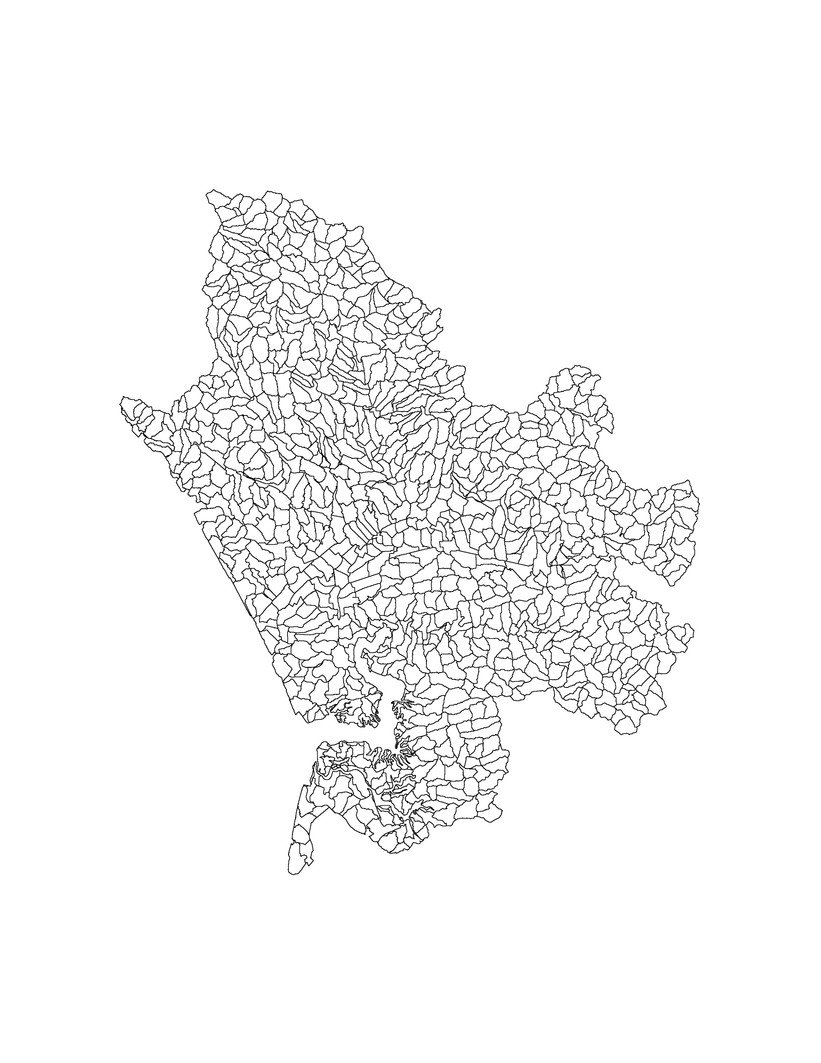
1025 topographically delineated hydrological response units (HRUs) 0.1-1.0 km²
Soil properties are averaged with these HRUs
Model is run at the scale of the HRUs
Assuming storm water collection and infiltration using basins
Beganskas et al. 2019

Slide 18
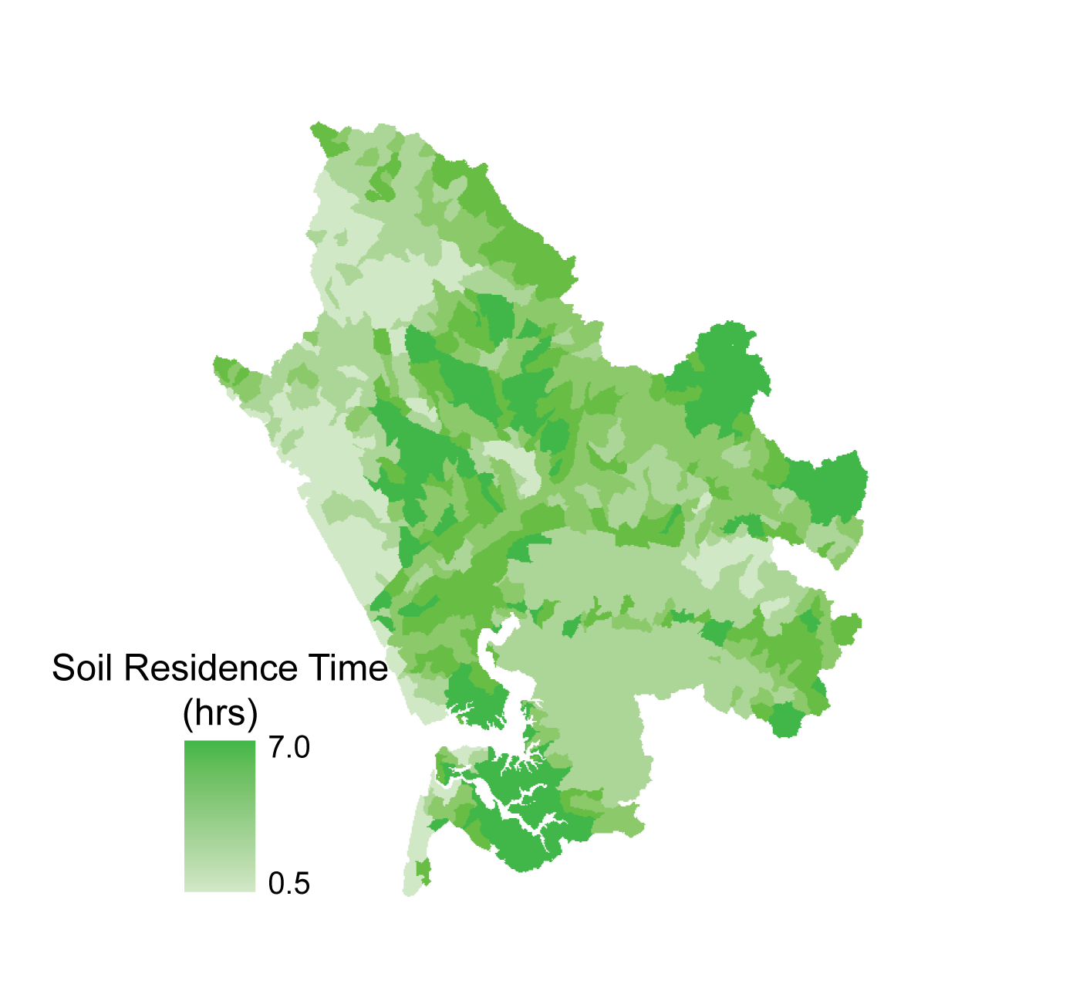
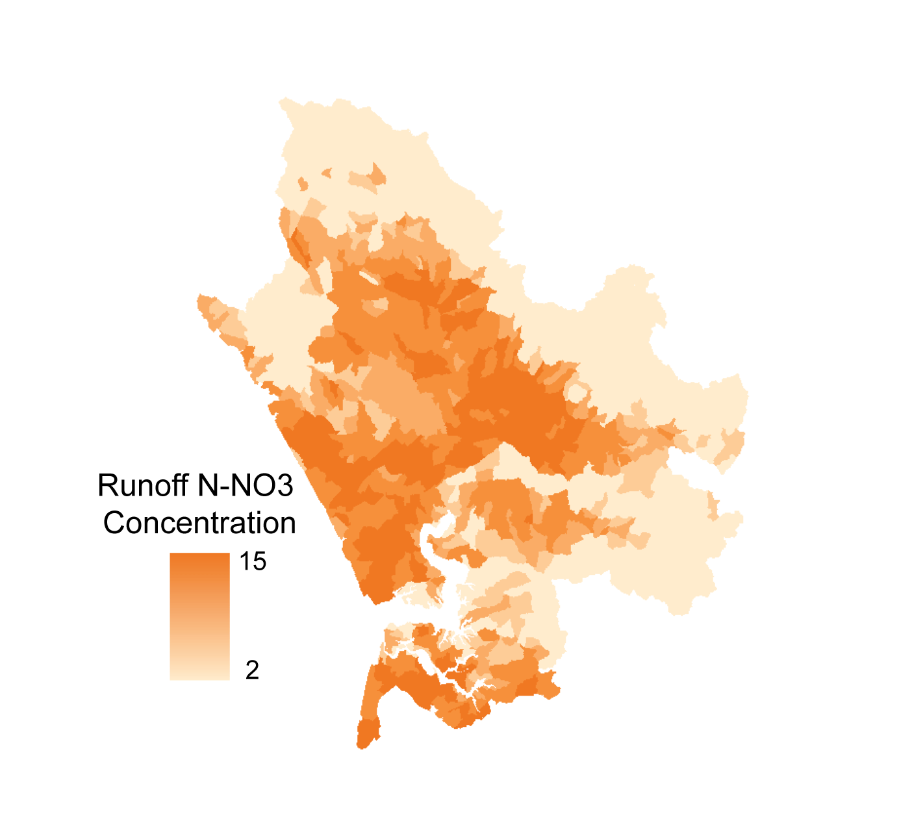
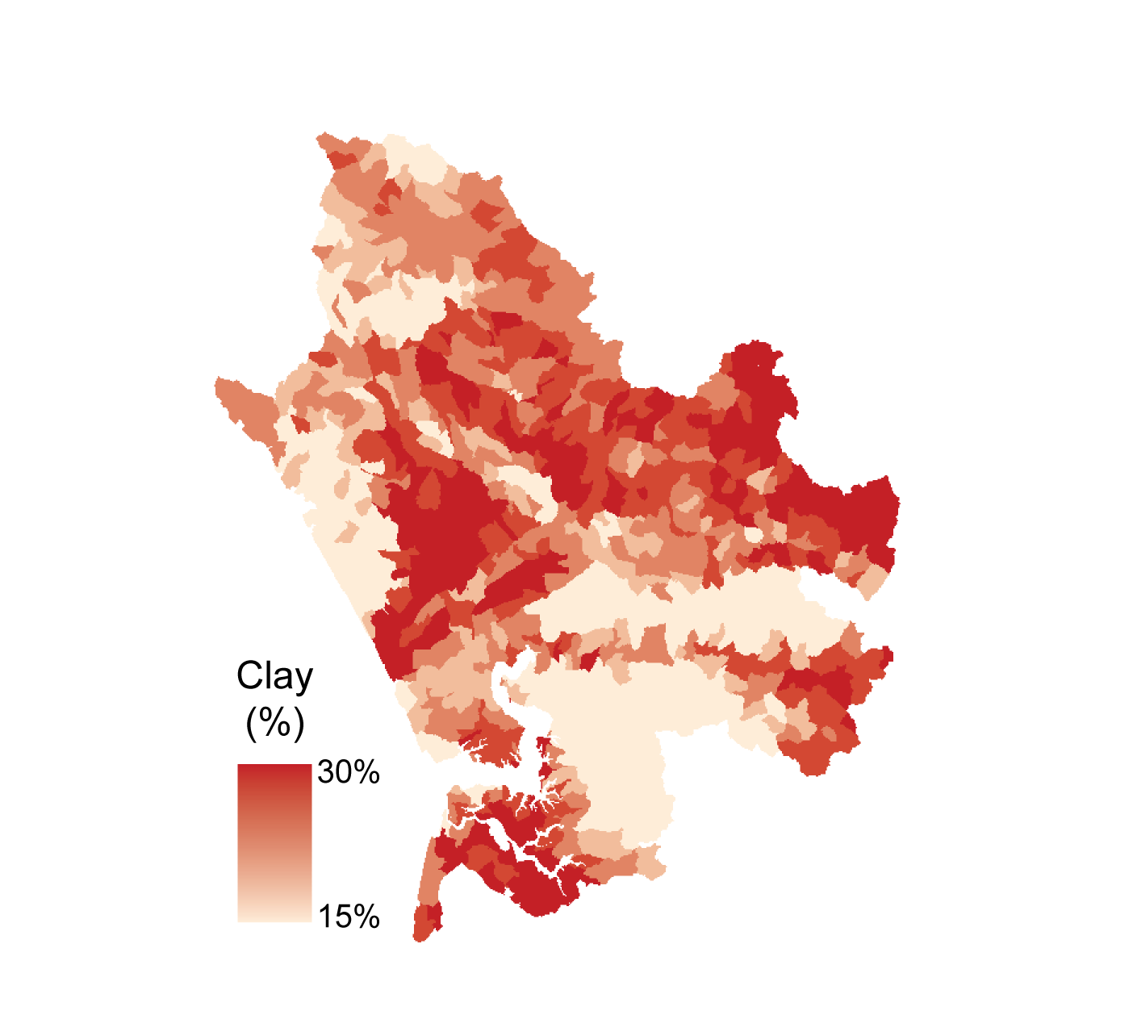
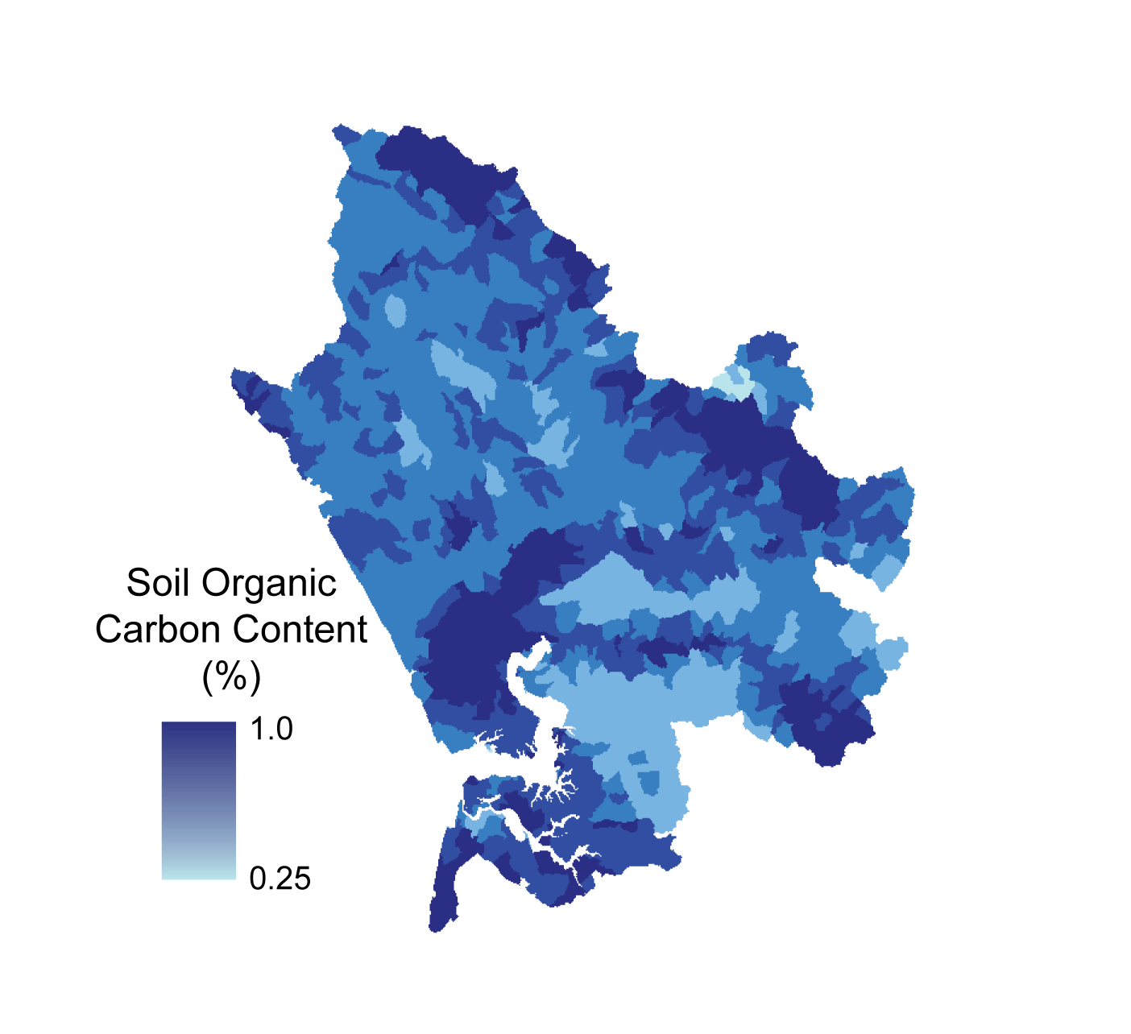
PREDICTORS
Initial Nitrate
Concentration
Soil Residence Time
Hours
N-NO3 ppm
10 km
10 km
Clay Content
Soil Organic Carbon
%-volume
%-weight
10 km
10 km

Slide 19
PREDICTORS
RESPONSE
Initial Nitrate
Concentration
Soil Residence Time
Amount of nitrate removed
Hours
N-NO3 ppm
10 km
10 km
Clay Content
Soil Organic Carbon
%-volume
%-weight
10 km
10 km
10 km

Slide 20
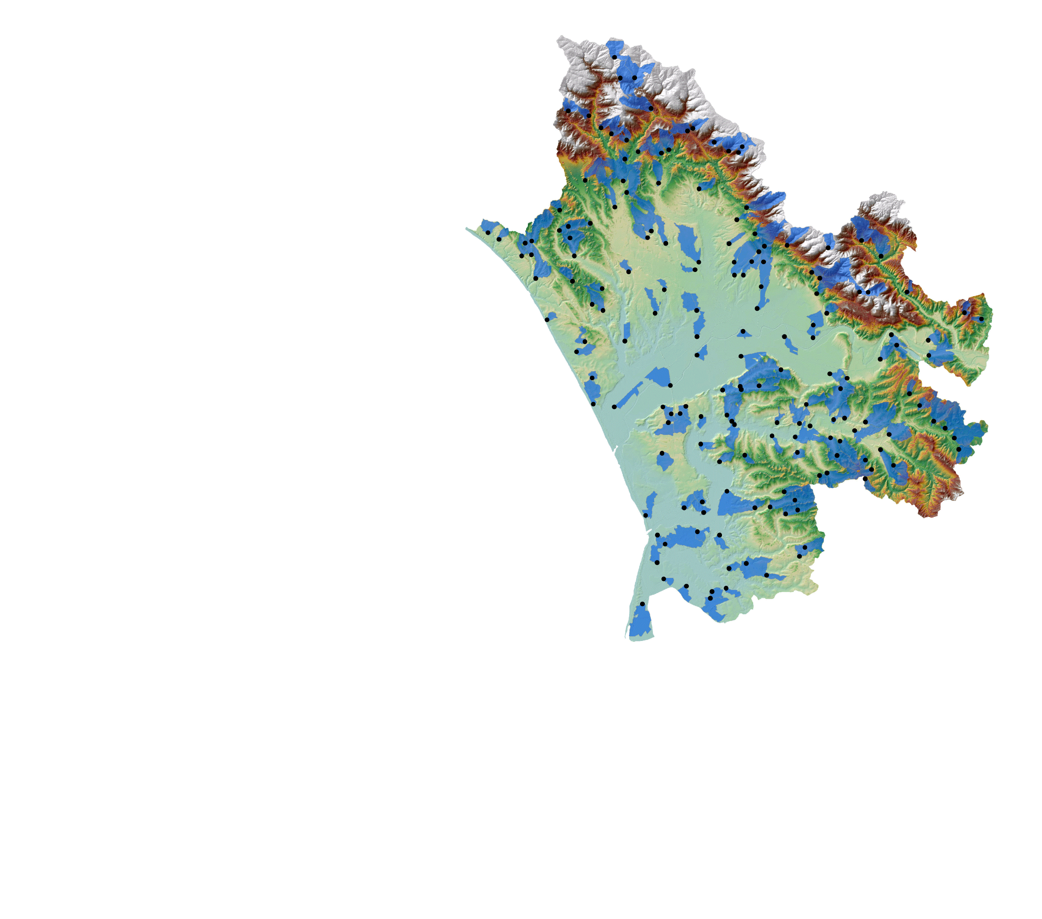
172 hypothetical storm water collection and infiltration projects
What effect will these projects have on groundwater quality?
10 km

Slide 21
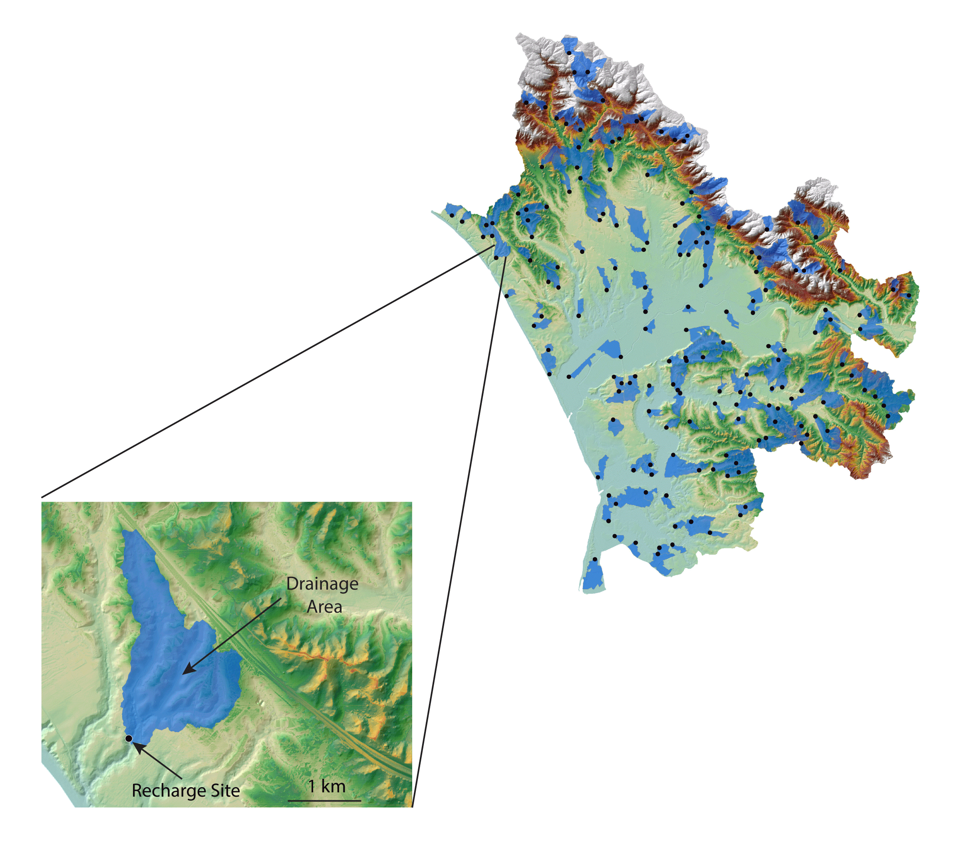
Drainage areas range from 50-500 acres
10 km
Located in areas of moderate to high suitability

Slide 22
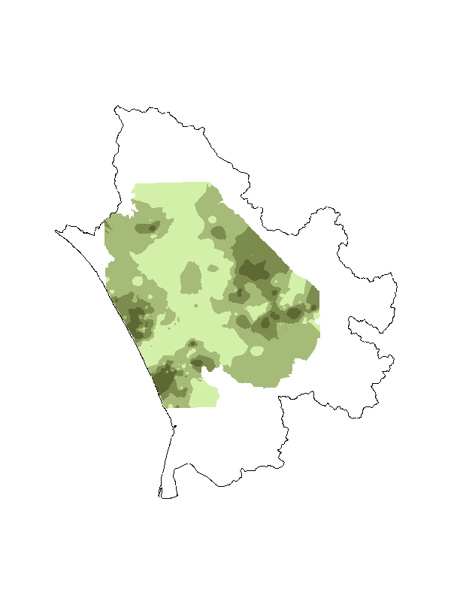
Average Groundwater Nitrate
Groundwater has elevated nitrate concentration in some areas
N-NO₃ (mg/L)*
< 2.5
2.5 - 10
10 - 25
> 25
10 km
* EPA maximum contaminant level is 10 mg-N/L

Slide 23
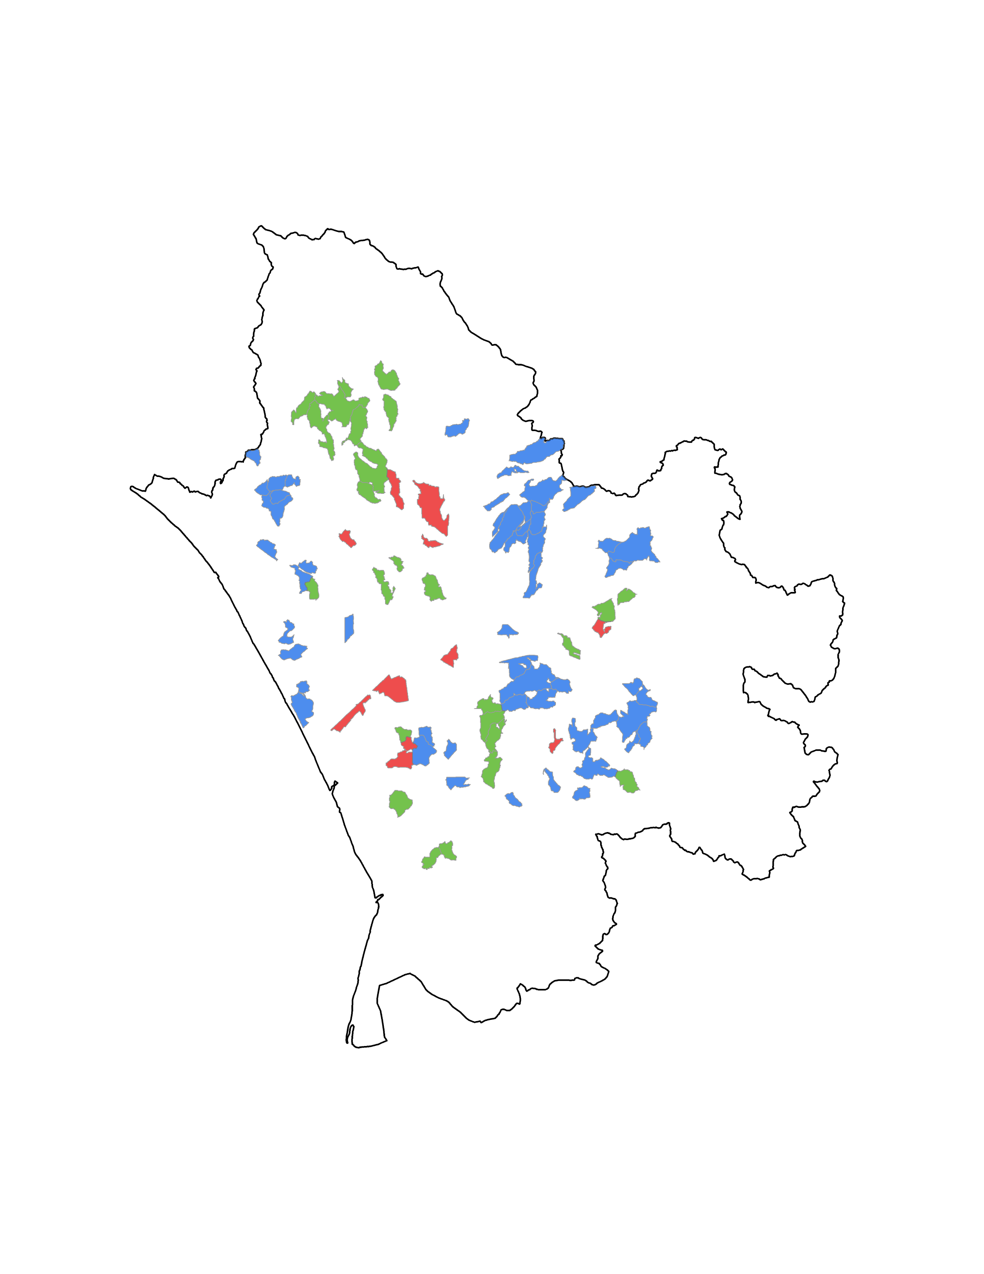
How does artificial recharge affect groundwater quality?
Initial NO₃ –
Amount NO₃ Removed
= Recharge NO₃
Compared to Groundwater NO₃
Better (> 5 mg/L)
Marginal (± 5 mg/L)
Worse (> 5 mg/L)
10 km

Slide 24
Incorporating water quality in MAR suitability
Incorporated data from multiple scales and experimental setups to develop a model of biogeochemical processing during infiltration
Used the model to make quantitative predictions about the impact of recharge on groundwater quality
Developed a framework for assessing the spatial variability of impact of recharge on water quality
10 km

Slide 25
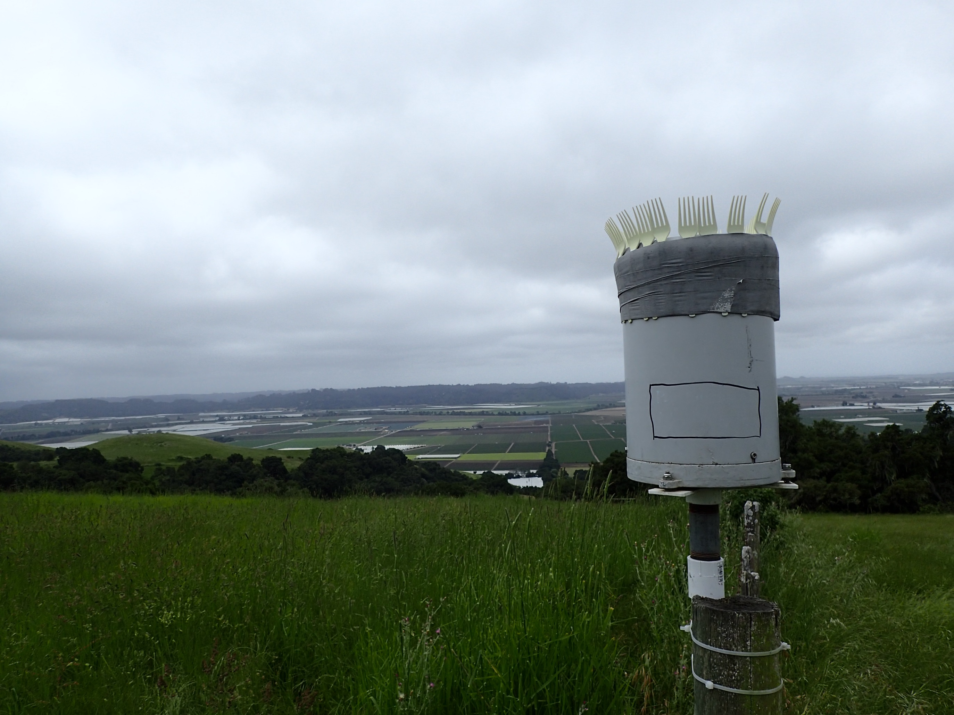




Acknowledgements
Sarah Farola, Paige Borges, Araceli Serrano, Dan Sampson, Stephen and Pamela Storrs, Kelli Camara, Bill Rice, Sarah Beganskas, Mark Burnett, Ryan Nyberg, Walker Weir, Tyler Stewart, Dom van den Dries, Rob Franks
Thank you!
10 km

Slide 26



Acknowledgements
Sarah Farola, Paige Borges, Araceli Serrano, Dan Sampson, Stephen and Pamela Storrs, Kelli Camara, Bill Rice, Sarah Beganskas, Mark Burnett, Ryan Nyberg, Walker Weir, Tyler Stewart, Dom van den Dries, Rob Franks
Thank you!
10 km

Slide 27
The neural net and random forest appear to reproduce trends in experimental data better than a linear regression
Likely due to interaction terms and non-linear relationships between predictors and response as well as missing data
Use modeled relationships, in conjunction with spatially mapped soil data to make predictions of denitrification

Slide 28
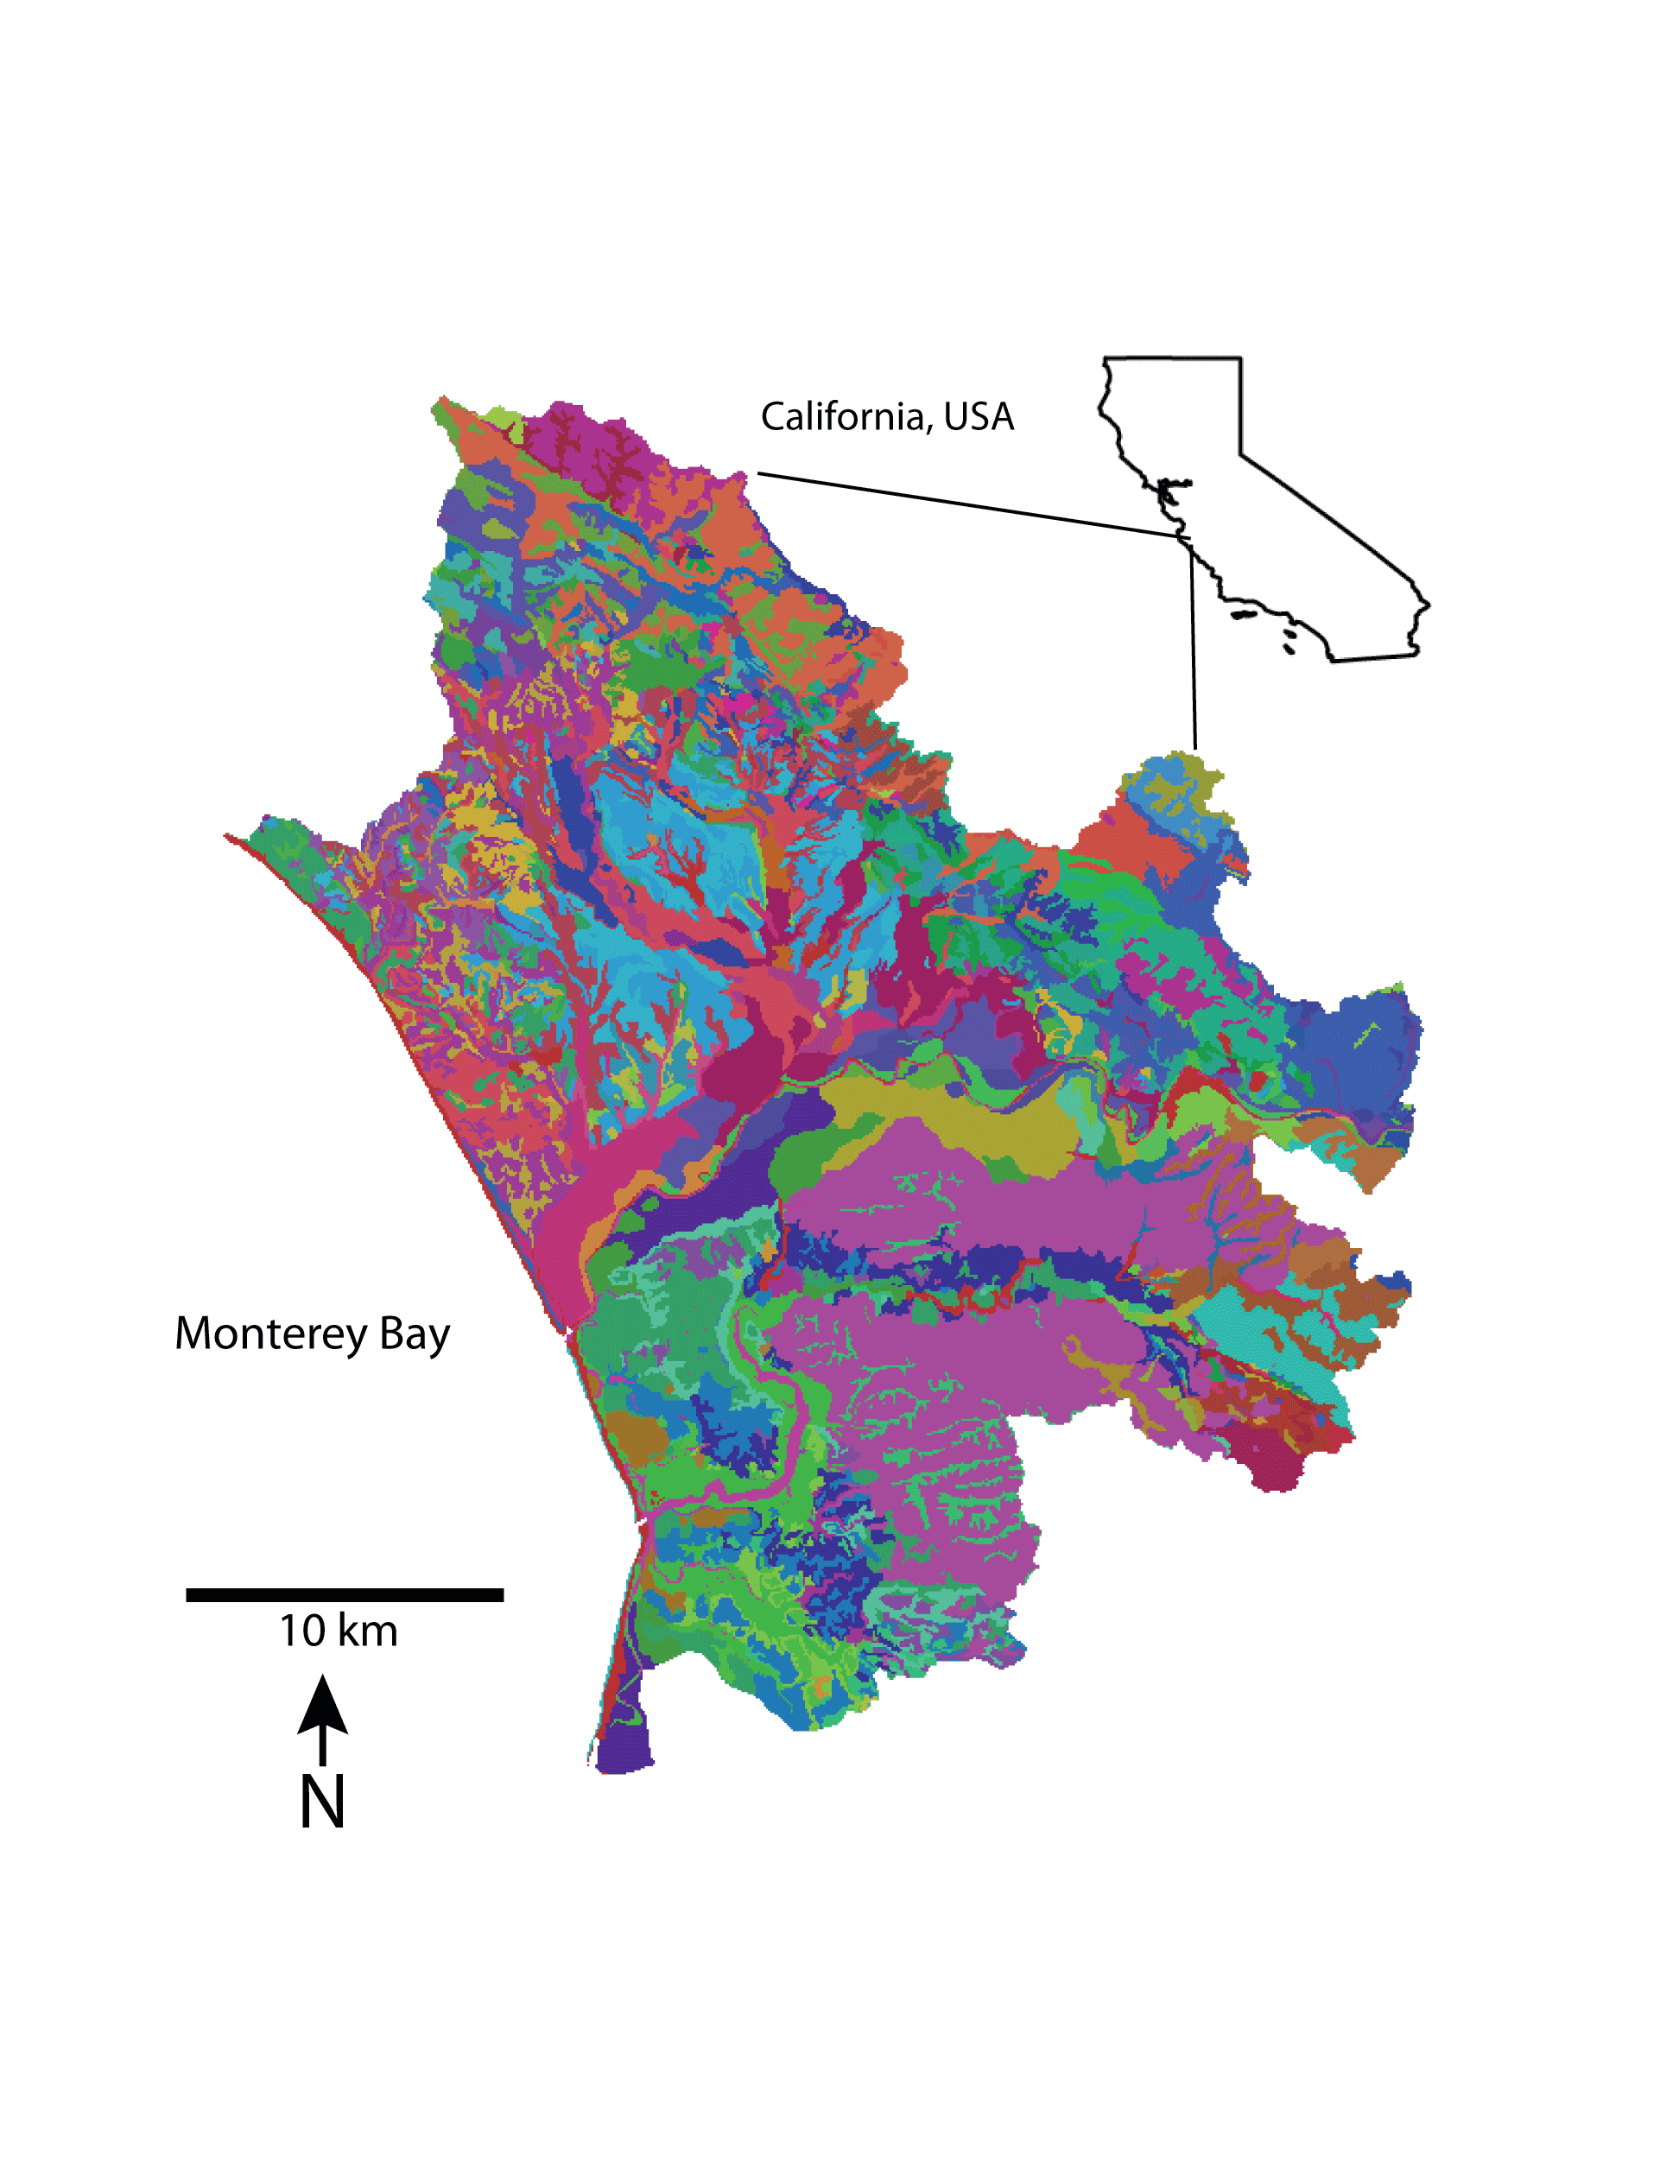
The Pajaro Valley is a complex area with over 100 individual soil units

Slide 29
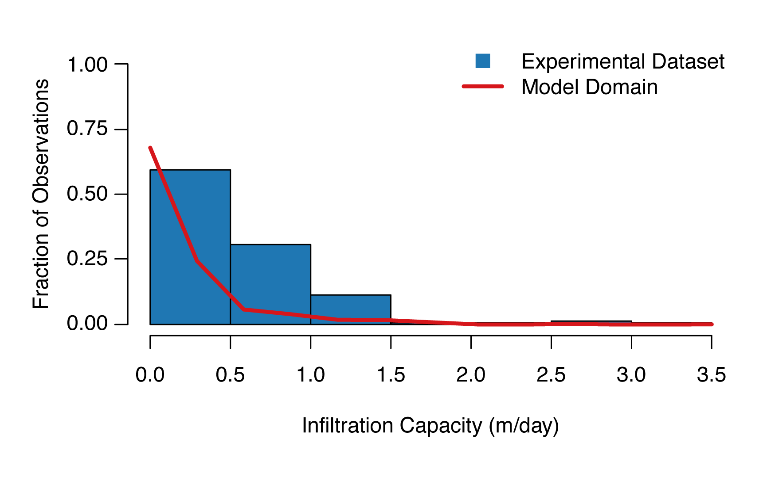
Our experimental data cover much of the range of soil properties in the modeling domain

Slide 30
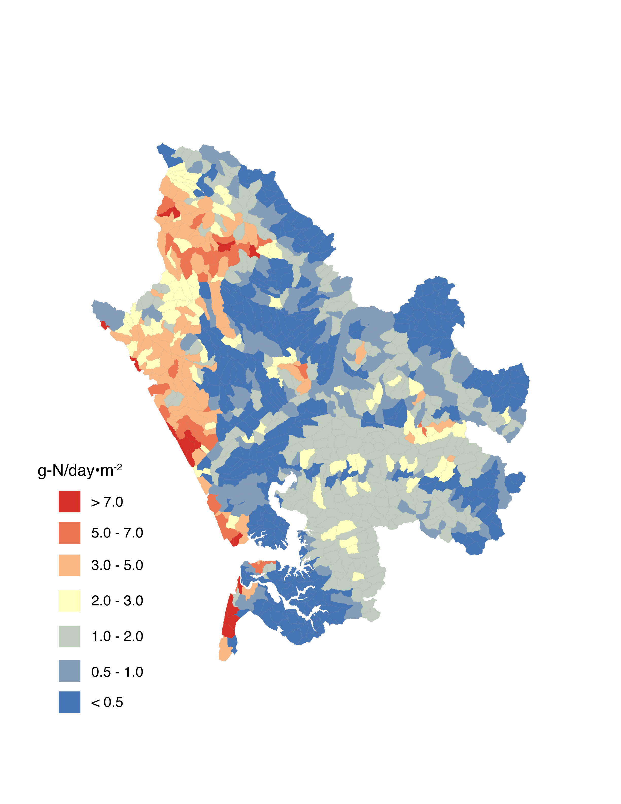
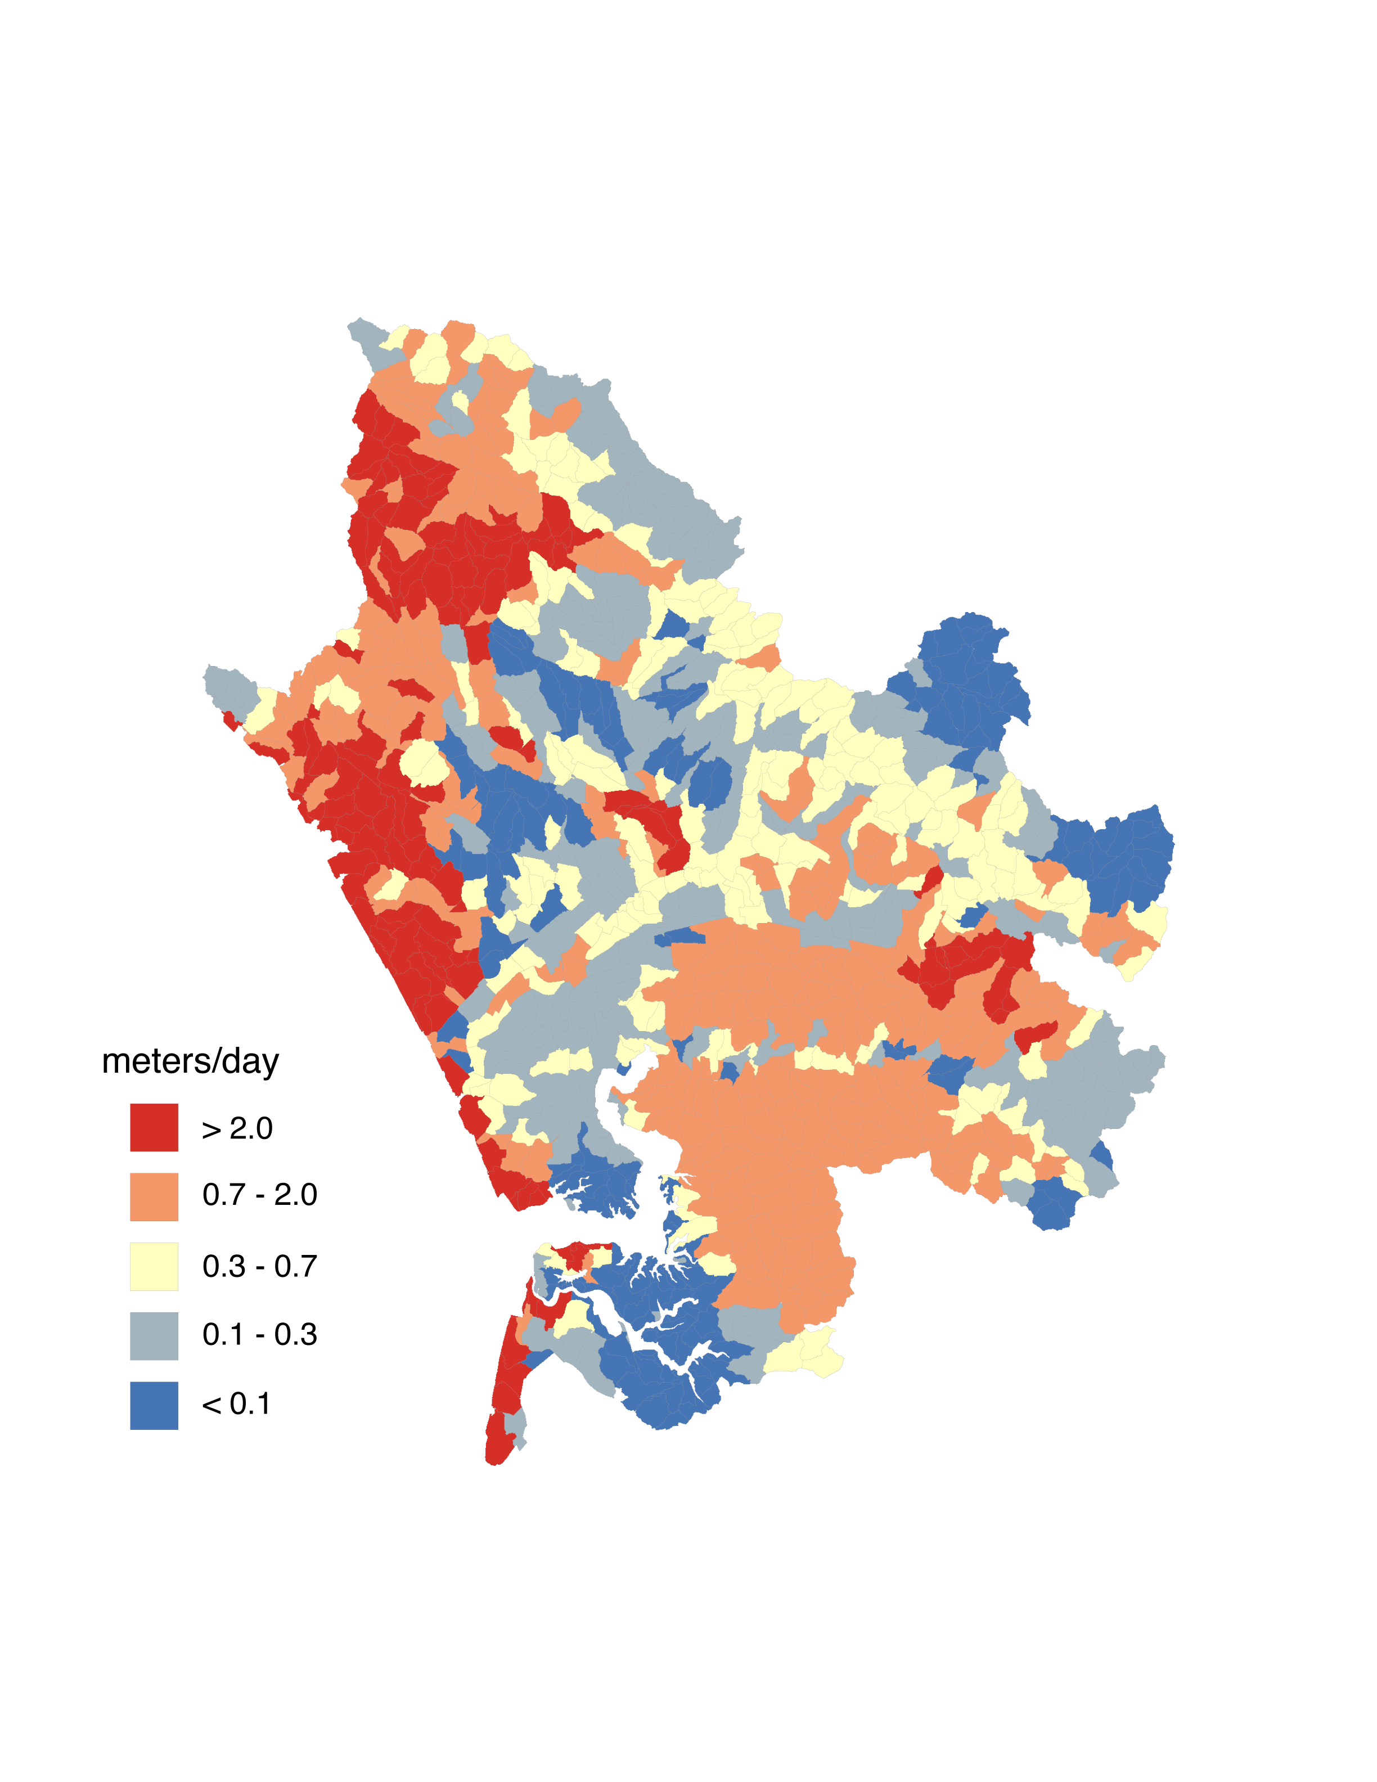
Potential Nitrate Removal
Potential Nitrate Load Reduction
Soil Infiltration Capacity

